Slide 1


Slide 2

AI-Powered Personalized Learning System

Slide 3
Group Members Introduction
Group Id: S25PROJECT63F44
Samra Ashfaq Khan: BC220201726
Abdulrehman: BC220201712

Slide 4

INTRODUCTION OF PROJECT
This project aims to develop an AI-driven personalized learning system that adapts to students' learning styles, strengths and weaknesses. The system will store student progress data, analyze their performance using AI and recommend customized learning materials, quizzes and study plans. It will use machine learning algorithms to predict areas where students need improvement and provide intelligent tutoring through chatbots and automated assessments.

Slide 5
Provide Here the Diagram of Process Model. You can make the diagram of process model according to your choice but it should be correct.

Slide 6
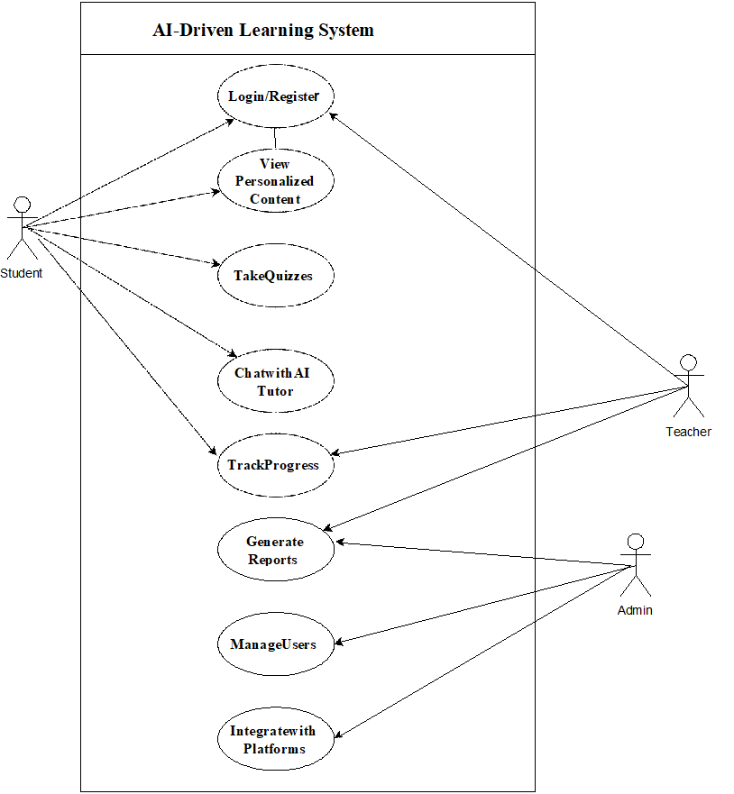
Use Case Diagram

Slide 7
Business Rules Catalog
Functional Requirements:
The system must support user authentication for students, teachers and administrators.
The system should manage a student database, including progress tracking, performance evaluation and learning history.
The system should utilize AI to provide personalized learning recommendations and adaptive content suggestions.
The system must generate automated quizzes and assessments tailored to student weaknesses.
The system should feature an AI-powered chatbot tutor to assist students with queries using NLP.
The system should include a dashboard for teachers to monitor student progress and analyze performance metrics.
The system must ensure secure storage of educational resources and student data.
The system should integrate with online learning platforms such as Moodle, Coursera, and similar services.

Slide 8
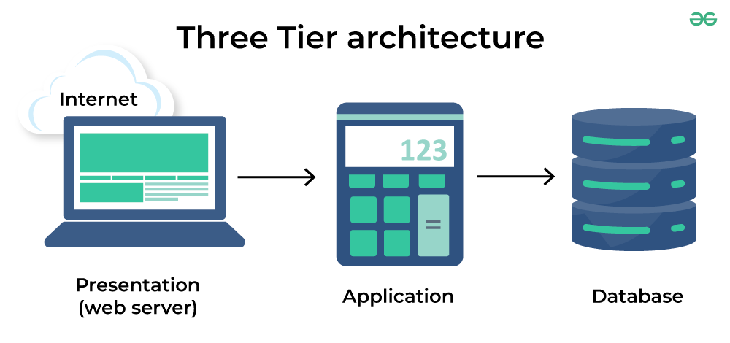
Architectural Design

Slide 9
Team Structure
Supervisor: Saima Munawar
Members
Samra Ashfaq Khan: BC220201726
Abdulrehman: BC220201712
Group Id: S25PROJECT63F44

Slide 10
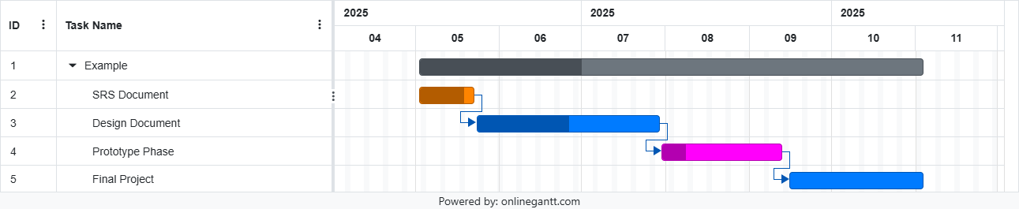
Project Schedule

Slide 11
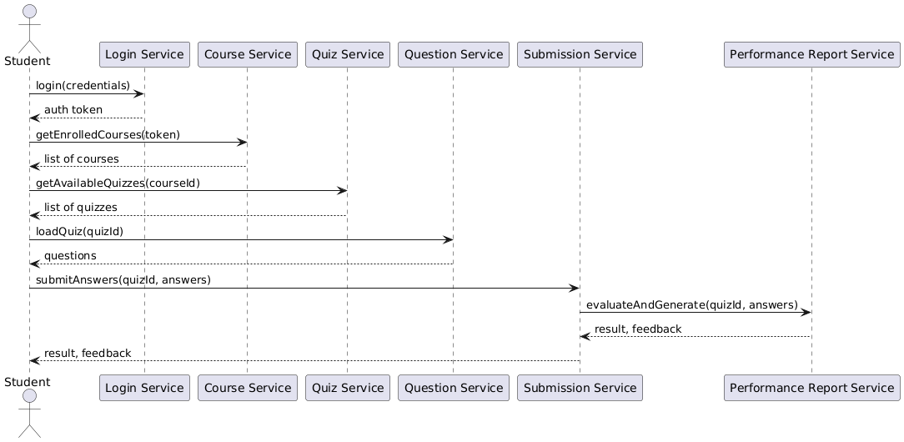
Sequence Diagrams

Slide 12
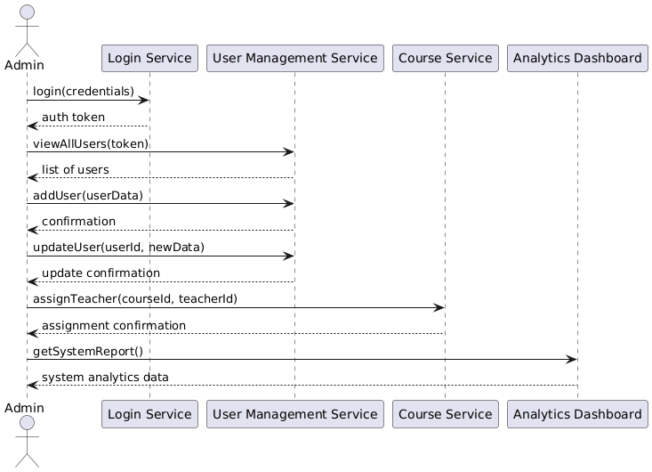
Sequence Diagrams

Slide 13
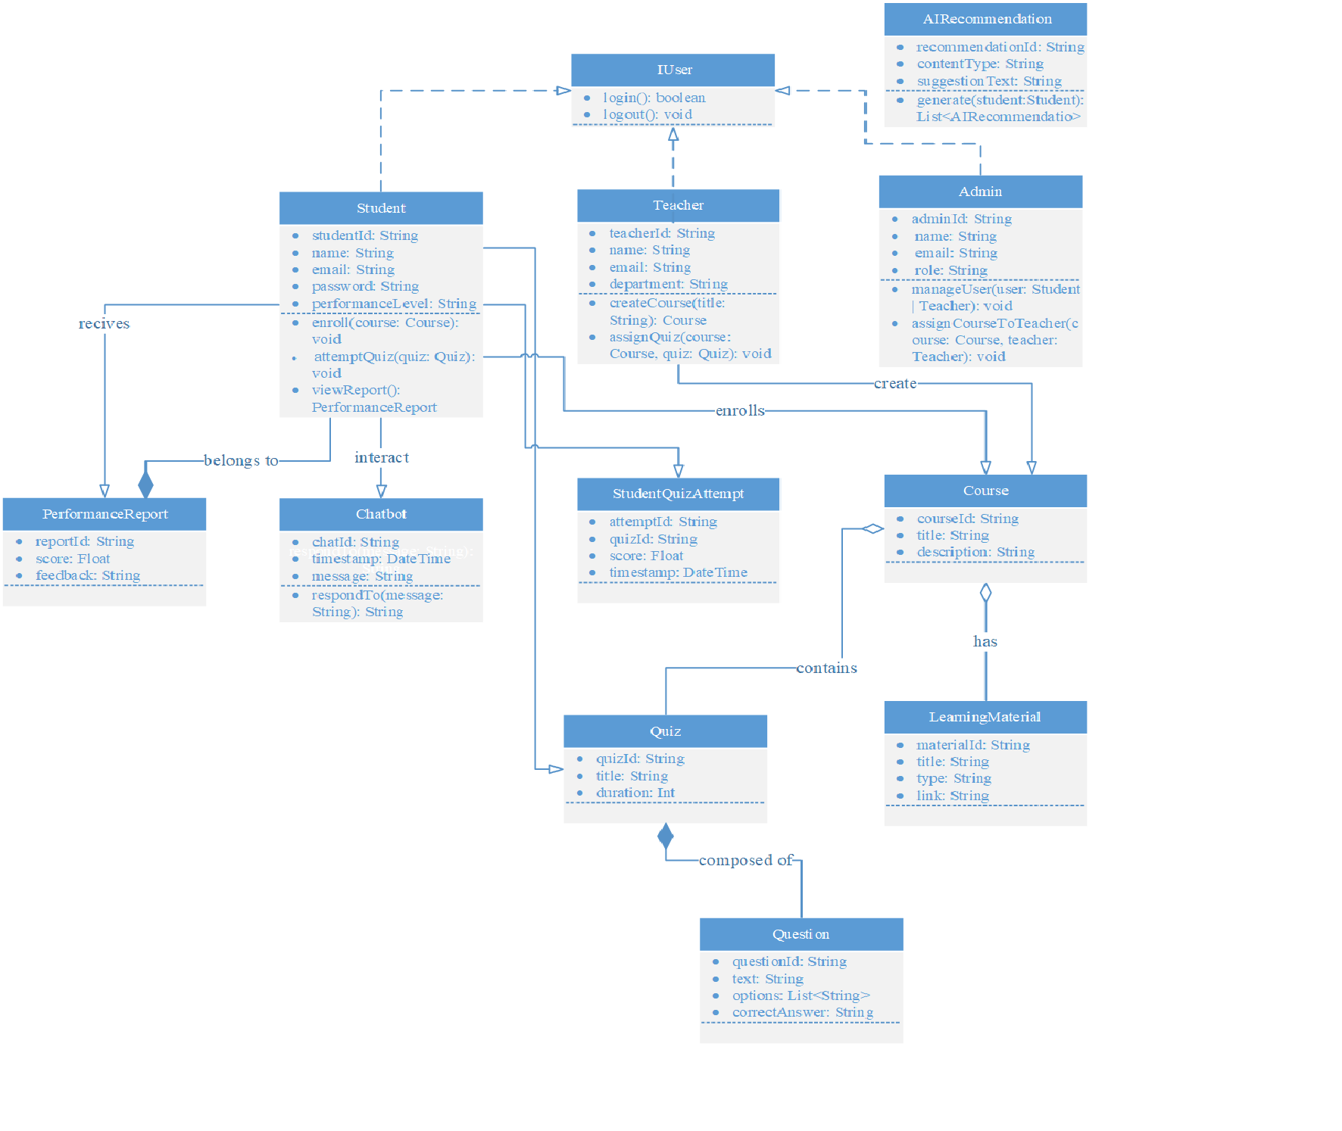
Logical Model/Class Diagram

Slide 14
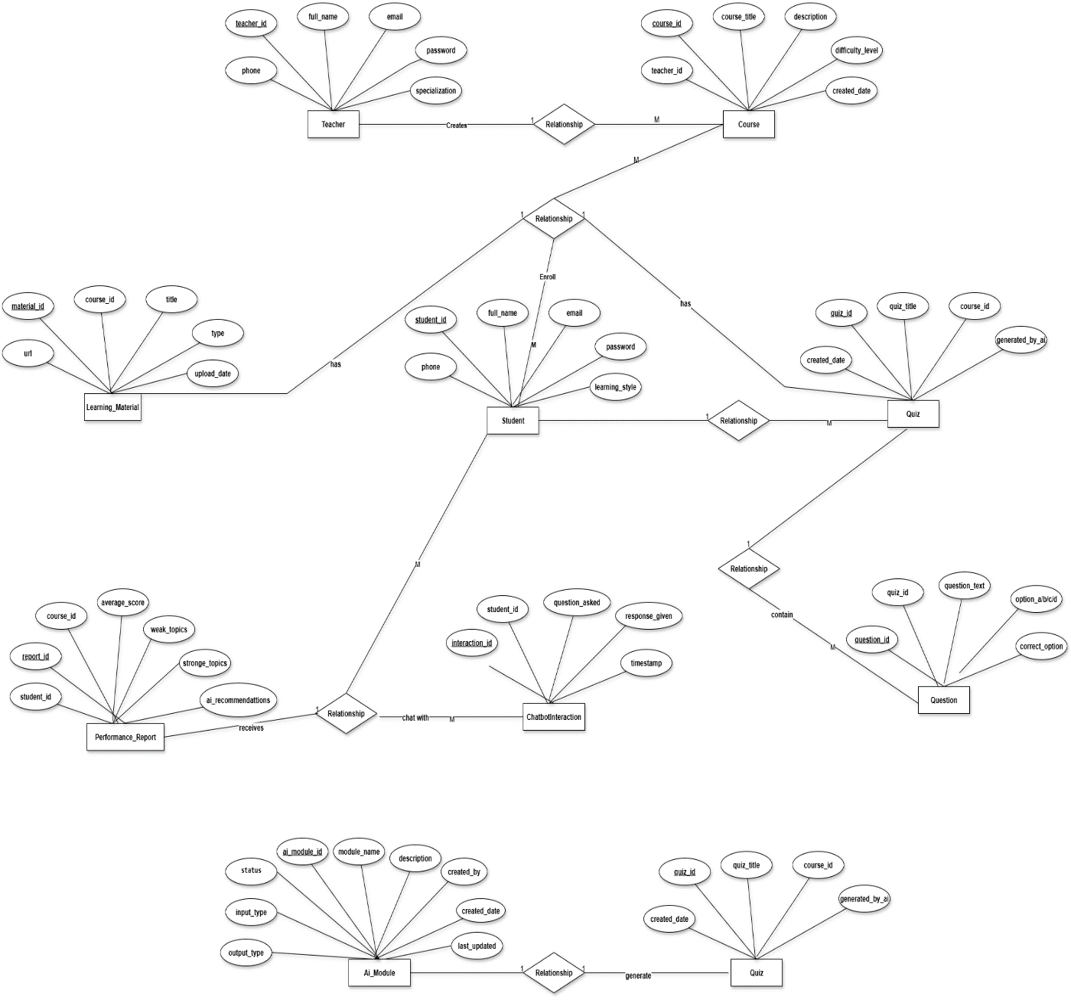
Entity-Relationship Diagram

Slide 15
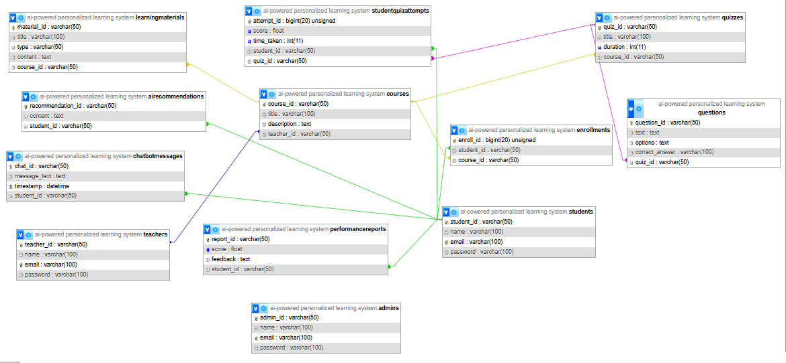
Database Diagram

Slide 16
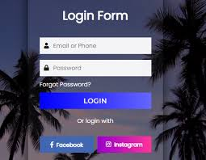
User Interfaces

Slide 17
Tools
HTML
CSS
BOOTSTRAP
PHP
MYSQL
VISUAL STUDIO CODE
MS VISIO

